Slide 1
System Software: Interfaces Hierarchy & Trends

Slide 2
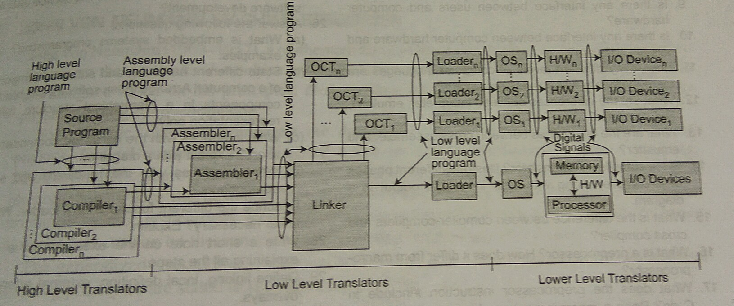
Software Hierarchy
High Level Translator
Low Level Translator
Highest Level Translator
<number>
Notes:
<number>
Page No 51, System Programming by Srimanta Pal

Slide 3
Interfaces
User’s Interfaces : A system of interaction between the hardware & the user is necessary to perform task.
System’s Interfaces: A mechanism for interaction between the Physical & Logical component that enables them to communicate with each other.
Notes:
<number>

Slide 4
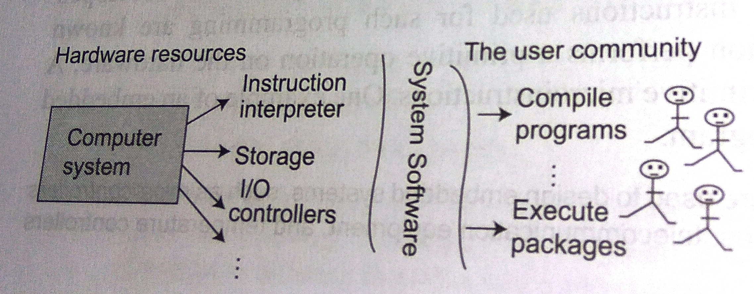
Interfaces : User’s Interfaces
Notes:
<number>

Slide 5
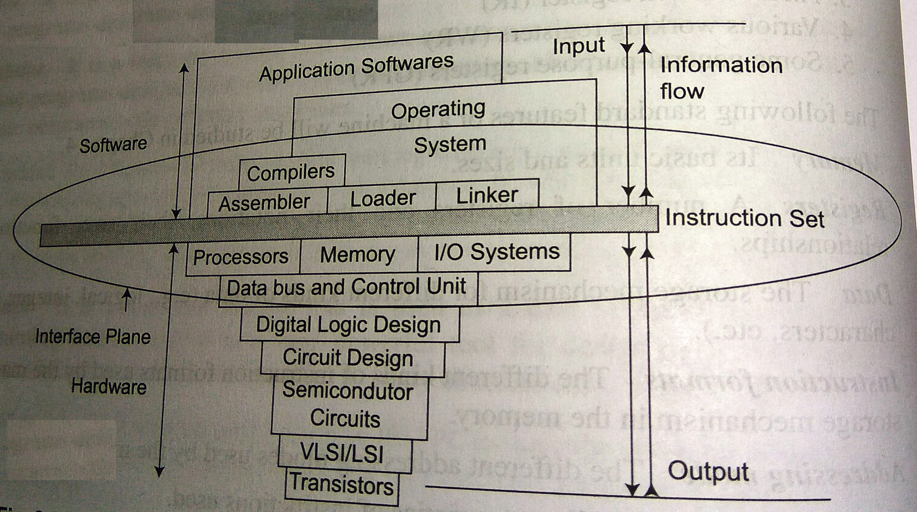
Interfaces (System’s Interfaces)
7/29/15
<number>
Notes:
<number>

Slide 6
Address Spaces
Logical Space
Physical Space
Features | Logical | Physical
Size | Start From ) to the size of segments | May not start from 0
Appearance | Contiguous | Non Contiguous
Notes:
Page No 41 (Srimanata Pal)
Physical address Physical address is the actual memory address which denotes a memory area in your storage device. Physical address refers to the address that comes with the device itself and that remains permanent for a device. It cannot be changed . For example the MAC(Medium Access Control) Address is a physical address.
Logical address The operating system or some other programs uses base addresses as a measure to find addresses. Here base address means starting address of a memory block. According to the program written the CPU generates a address.This address is added with the base address so that it forms the physical address.Here in this case the address generated by the CPU is called as Logical Address. The address which is generated by the CPU which is added with base address to form th physical address is called as logical address
On the other hand , a logical address is the address that is given or assigned to a device which registers its presence on the internet highway. At a particular time this address will be unique for the device but it may change at some times in future. IPv4 is an example of Logical Address.
<number>

Slide 7
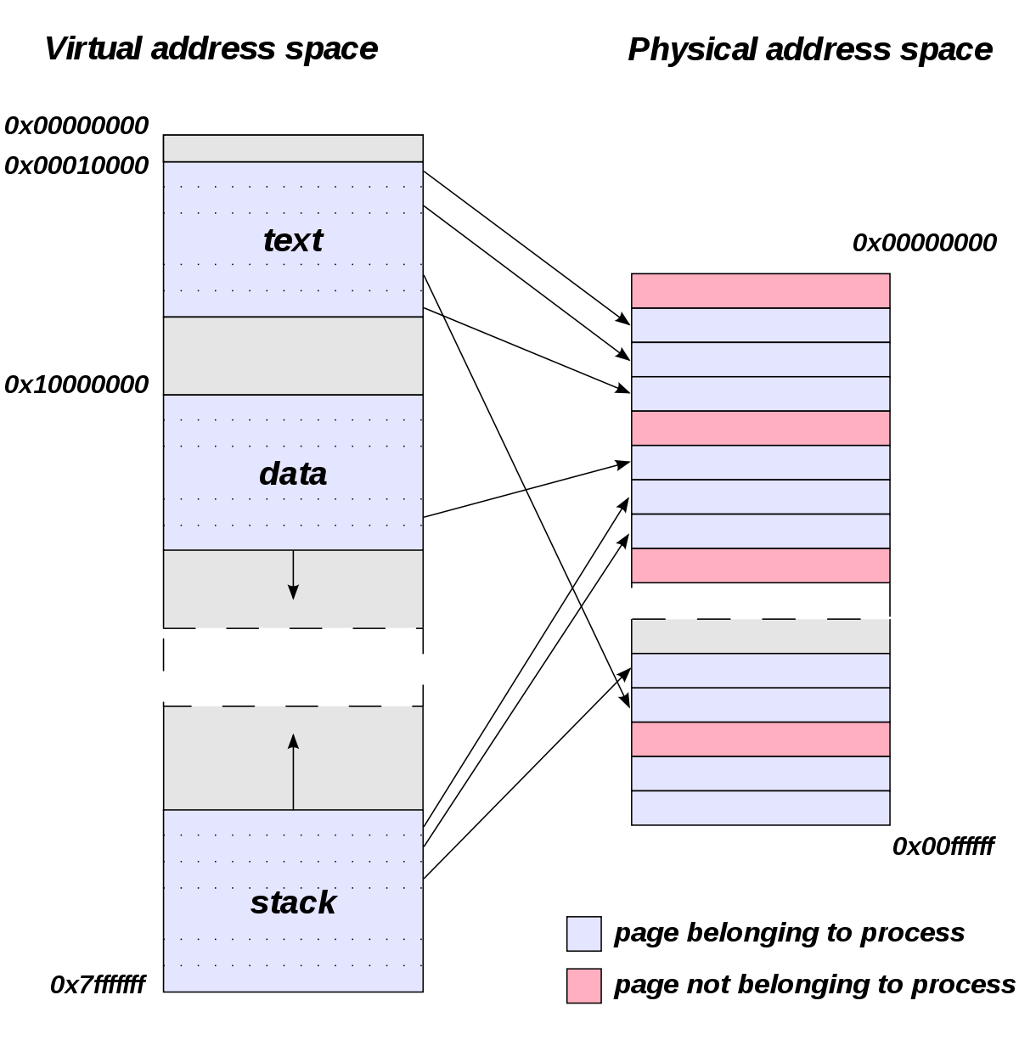
Address Spaces
Notes:
Page No 41 (Srimanata Pal)
<number>

Slide 8
Recent trends in software development.
1980+ 1990+ 2000+
Procedure
Oriented Software Development
Object Oriented Software Development
Service Oriented Software Development
Notes:
<number>
For example, most databases run as a service on a server. It listens for connections, and then listens for requests and provides responses to those requests. 2) Design those programs to establish connections with each other, and use message passing as the key to performing work. For example, you might have the MySQL service running, and the Apache service running. A request is sent to the Apache service from over the internet. It, in turn, connects to the MySQL service (via a PHP script) and sends a sequence of messages. The result of processing those messages is then sent back to the requestor as an HTML page.

Slide 9
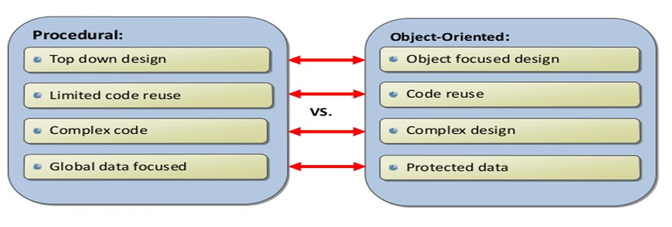
Procedure Oriented Programming Vs Object Oriented Programming
Notes:
1.Programs is divided into Functions. (POP). Programs are divided into objects(oops)
2. Most of the functions share Global data. Data Structures are characterized by objects.
3.Need less memory(POP), Require more memory(OOP)
4. It doesn’t have access specifier.
It has access specifier like public, private, protected
<number>

Slide 10
Thank You!

